Slide 1
Lecture 7: Simple Linear Regression
Jibo He, Ph.D.
Associate Professor
Wichita State University
jibo.he@Wichita.edu

Slide 2
Research Questions
Many research questions involve determining the relationship between two quantitative variables. For example,
Frequency of exercise & Blood pressure
Number of friends & Life satisfaction
High-school GPA & College GPA
Hours of sleep per night & Daily caffeine intake

Slide 3
Review about Correlation
Correlation is a data analysis technique for describing the degree of relationship between two variables. “Correlation” addresses the question: “How are scores on one variable associated with (or related to) scores on another variable?”
We are only interested in the Linear relationship.
Scatter plot
Positive/negative correlation
Strength or degree of correlation: check how tightly/loosely the points scatter around the straight line

Slide 4
Review about Correlation
Covariance
The covariance is dependent on the measurement scale. For example, consider the covariance between height and weight if height is measured in feet and weight is measured in pounds and if height is measured in inches and weight is measured in pounds
Correlation

Slide 5
Example
Two variables, X and Y, are the focus of the study. The study involves 14 research participants. The sum of the cross products (Z_{X} *Z_{Y}) for the 14 cases is -11.62. Calculate and interpret r_{XY.}

Slide 6
Example
Two variables, X and Y, are the focus of the study. The study involves 14 research participants. The sum of the cross products (Z_{X} *Z_{Y}) for the 14 cases is -11.62. Calculate and interpret r_{XY.}
Answer: r=-11.62/13=-0.89, strong negative correlation.

Slide 7
Exercise
Two variables, X and Y, are the focus of the study. The study involves 25 research participants. The sum of the cross products (Z_{X} *Z_{Y}) for the 25 cases is 21.58. Calculate and interpret r_{XY.}
Notes:
21.58/24=0.90

Slide 8
What you should know about the correlation coefficient
It takes values from –1 to +1;
It indicates the strength of a linear relation (its absolute value) and the direction of the relation (its sign).
The further the correlation is from 0, the stronger the linear relationship between the variables.
Correlation does not establish causation

Slide 9
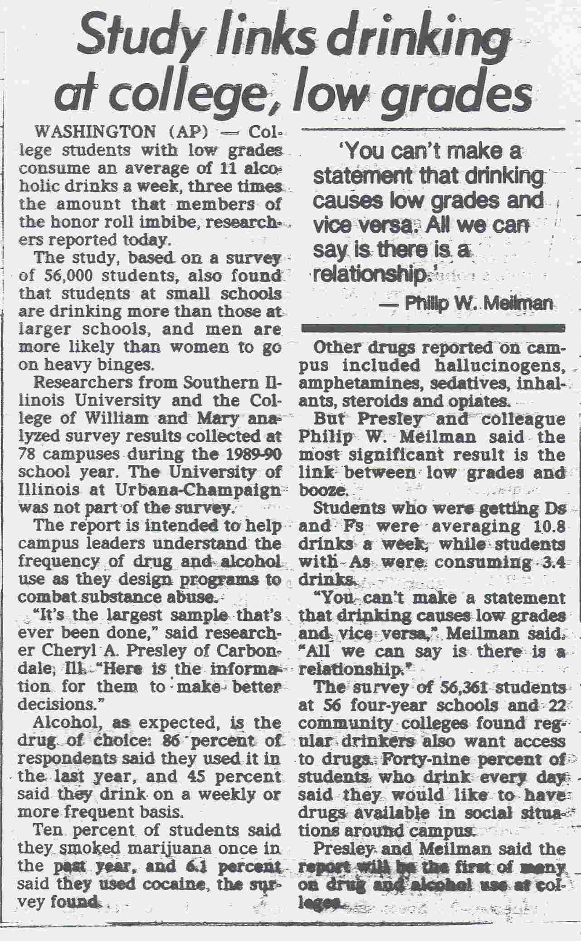

Slide 10
Research Questions
Frequency of exercise & Blood pressure
Correlational research on exercise and blood pressure consistently finds that those who exercise more have lower blood pressure. It might be useful to know exactly how much exercise is needed to achieve a specific blood pressure.
Questions such as these cannot be answered by knowing only the correlation between two variables. A mathematical equation (known as regression equation) with a known form is needed that can relate one variable to the other.

Slide 11
Correlation versus Regression
Correlation
Looking at the scatter surrounding a line
Explaining the linear relationship between two variables
Linear regression determines the shape of a line
If we draw a line through the scatterplot, what would be the best place to put that line?
If x=0, where would be a good guess for y?
What is the typical change in y for an increase in x?
Notes:
After knowing the position of the line, we would be able to answer:

Slide 12
Simple Linear Regression
PREDICTING one variable (Y) from another (X)
No longer symmetric like Correlation
One variable is used to “explain” another variable
X Variable
Independent Variable
Predictor Variable
Y Variable
Dependent Variable
Criterion Variable

Slide 13
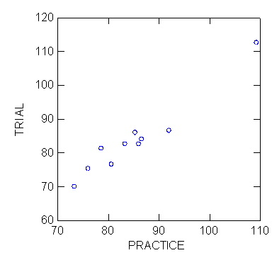

Slide 14
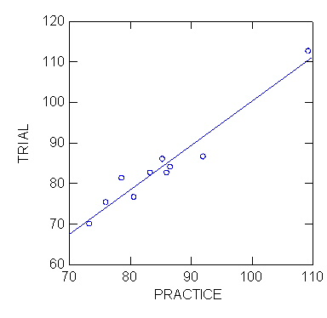

Slide 15
Prediction: What can we learn from correlation?
Scores on variables Y and X should be correlated to some extent in order to predict scores on one variable using scores on the other variable. Stronger values of rxy lead to greater accuracy of prediction, that is:
A value of 1.0 or –1.0 will lead to perfect prediction (What about rxy = 0?)

Slide 16
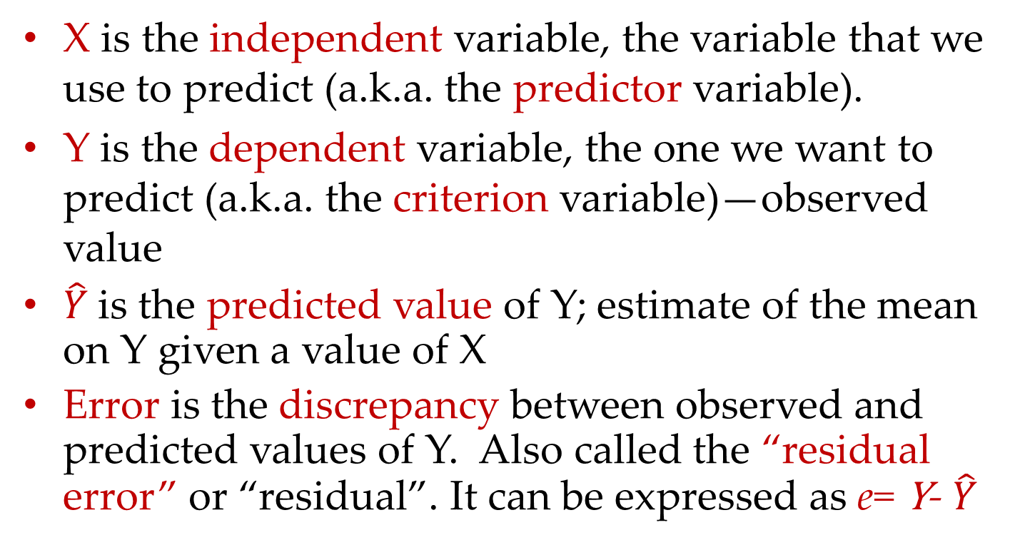
Definitions
X is the independent variable, the variable that we use to predict (a.k.a. the predictor variable).
Y is the dependent variable, the one we want to predict (a.k.a. the criterion variable)—observed value
$\hat{Y}$is the predicted value of Y; estimate of the mean on Y given a value of X
Error is the discrepancy between observed and predicted values of Y. Also called the “residual error” or “residual”. It can be expressed as e= Y- $\hat{Y}$
Notes:
Let us suppose X is the height, and Y is the weight

Slide 17
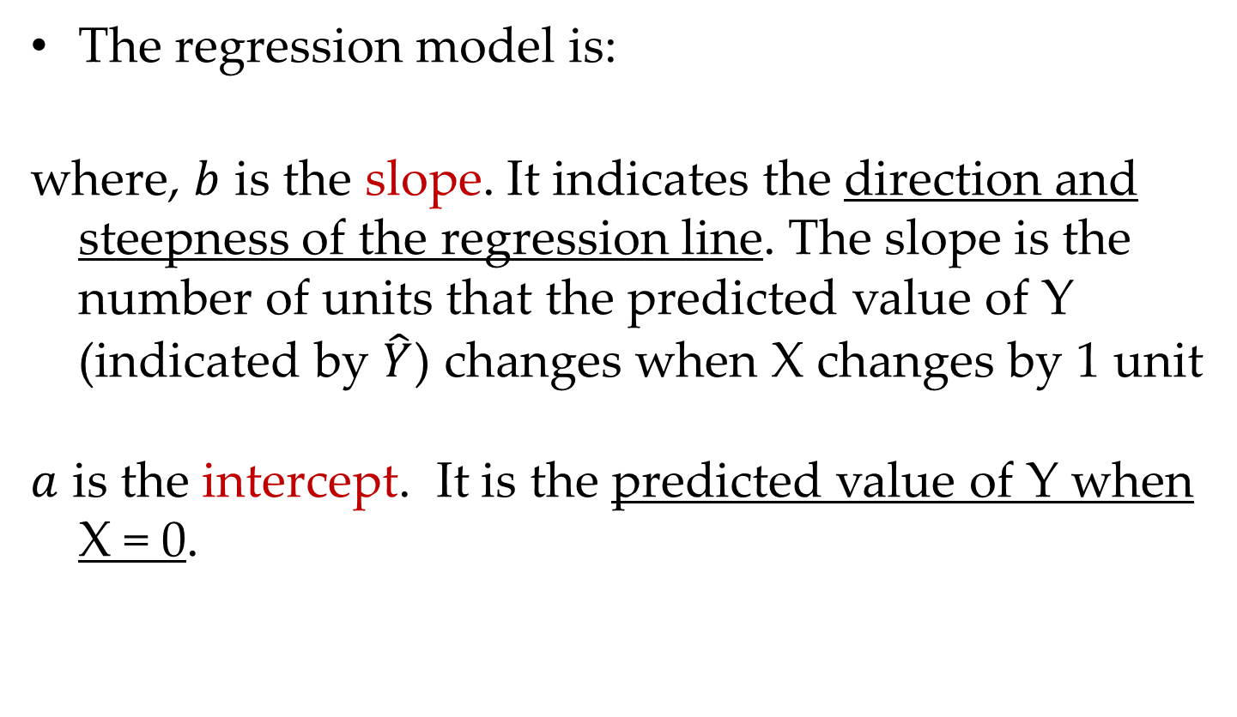
Defining the Regression Equation
The regression model is:
where, $b$ is the slope. It indicates the direction and steepness of the regression line. The slope is the number of units that the predicted value of Y (indicated by $\hat{Y}$) changes when X changes by 1 unit
$a$ is the intercept. It is the predicted value of Y when X = 0.

Slide 18
Illustration of Regression Line

Slide 19
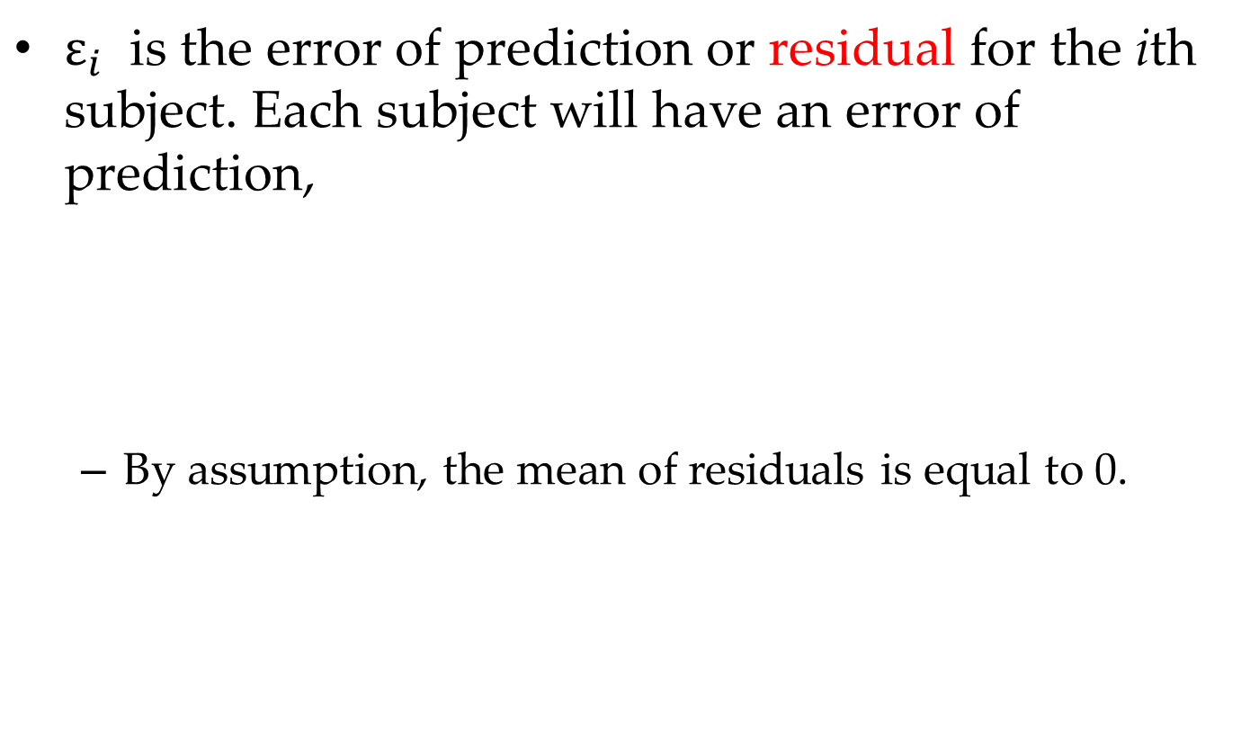
Defining the Regression Equation
$ε_{i}$ is the error of prediction or residual for the ith subject. Each subject will have an error of prediction,
By assumption, the mean of residuals is equal to 0.

Slide 20
(Simple) Linear Function Y=a+bX
Slope
Intercept
Y
bX+a
b
(0,a)
X
We are interested in this to model the relationship between an
independent variable X and a dependent variable Y

Slide 21
Simple Linear Regression
Y
all data points would
fall right on the line
1
X

Slide 22
A guess at the location of the regression line
Y
X

Slide 23
Another guess at the location of the regression line
(same slope, different intercept)
Y
X

Slide 24
Initial guess at the location of the regression line
Y
X

Slide 25
Another guess at the location of the regression line
(same intercept, different slope)
Y
X

Slide 26
Initial guess at the location of the regression line
Y
X

Slide 27
Another guess at the location of the regression line
(different intercept and slope, same “center”)
Y
X

Slide 28
We will end up being reasonably confident
that the true regression line is somewhere
in the indicated region.
Y
X

Slide 29
Estimated Regression Line
Y
errors/residuals
X

Slide 30
Estimated Regression Line
Y
Wrong Picture!
Error Terms have to be drawn vertically
Wrong Picture!
X

Slide 31
Estimated Regression Line
Y
=“y hat”: predicted value of Y for X_{i}
X

Slide 32
Key Regression Procedures
Step 1: finding the regression equation: calculating slope and intercept of the equation for the best fitting line
Step 2: using the regression equation: predicting a person’s score
Step 3: assessing the quality of prediction: Coefficient of determination and Standard error of estimate

Slide 33
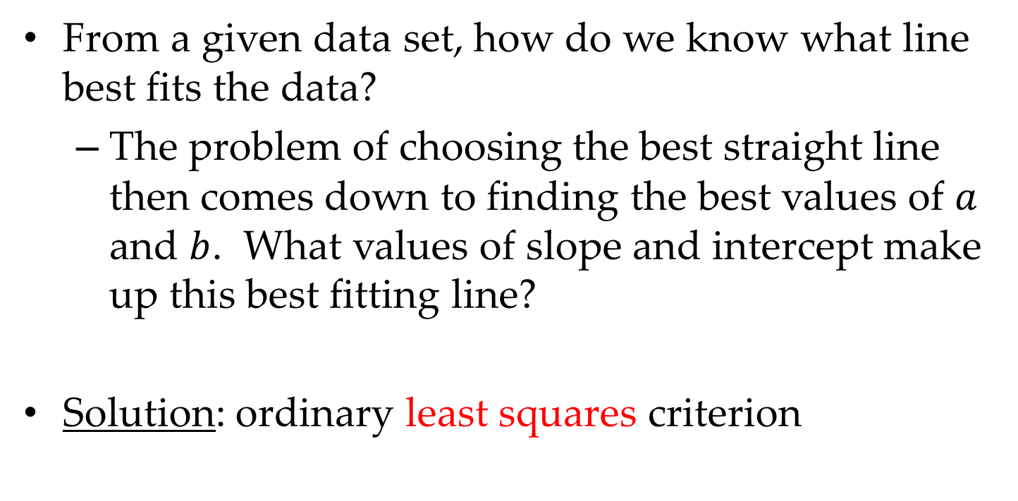
Finding the Regression Equation
From a given data set, how do we know what line best fits the data?
The problem of choosing the best straight line then comes down to finding the best values of $a$ and $b$. What values of slope and intercept make up this best fitting line?
Solution: ordinary least squares criterion

Slide 34
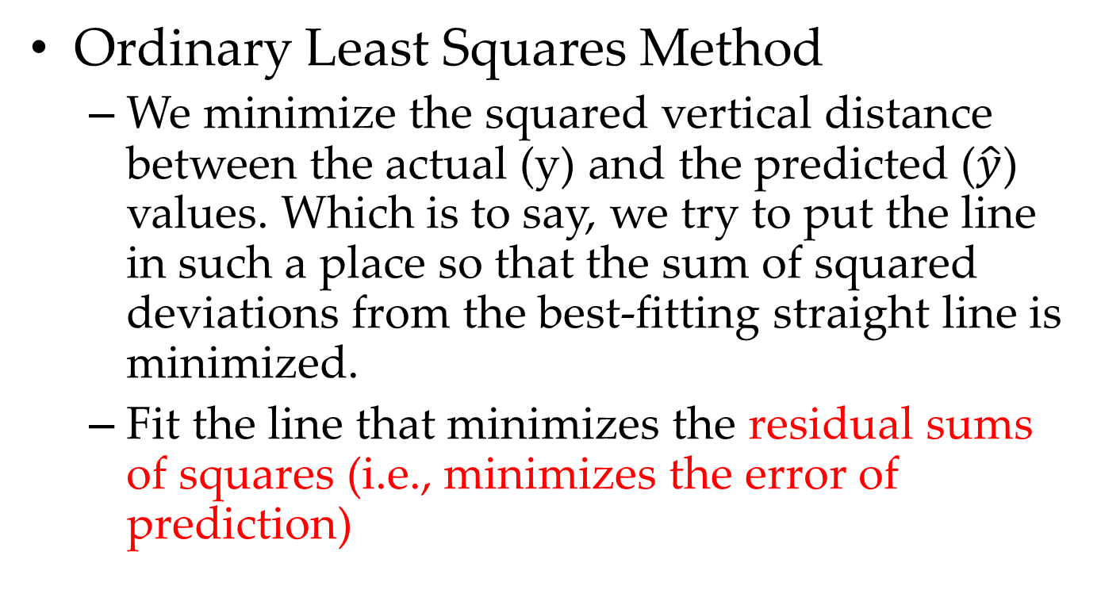
How to obtain the regression coefficient?
Ordinary Least Squares Method
We minimize the squared vertical distance between the actual (y) and the predicted ($\hat{y}$) values. Which is to say, we try to put the line in such a place so that the sum of squared deviations from the best-fitting straight line is minimized.
Fit the line that minimizes the residual sums of squares (i.e., minimizes the error of prediction)

Slide 35
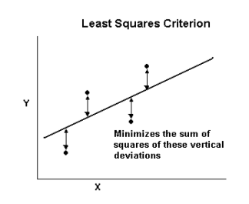
Visualize Least Squares Criterion

Slide 36
Parameter Estimates
Least square estimators
Notes:
If we standardize both variables, what happens?
If the slope is 0.75, for standardized data, we could say that one standard deviation increase in X will be reflected in three-quarters of a standard deviation increase in y hat.

Slide 37
Computing the regression equation slope & Y-intercept
Example:
A linear regression of midterm scores and attendance (note: this is real data). We ultimately want to predict someone’s midterm score using the number of classes students attended prior to taking the midterm. Make the midterm scores the Y variable and attendance the X variable.

Slide 38
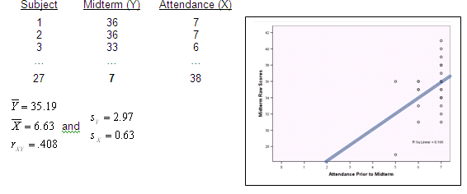
Computing the regression equation slope & Y-intercept

Slide 39
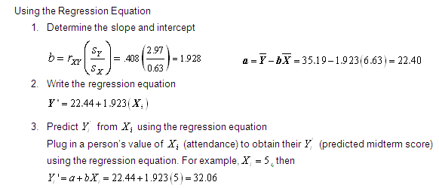
Notes:
This slide is for myself

Slide 40
Basic Assumptions (for Simple Linear Regressions)
X & Y are quantitative variables (Make sure the minimum level of underlying scale is interval)
Linear relationship between X & Y (draw scatter plot)
Independence of observations
For instance, you can not draw observations from twins
Make sure the sample is a random sample

Slide 41
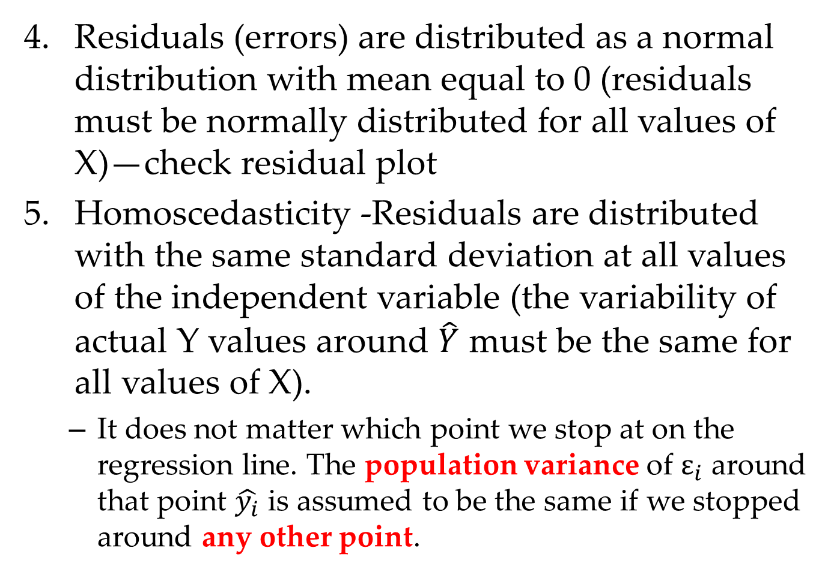
Residuals (errors) are distributed as a normal distribution with mean equal to 0 (residuals must be normally distributed for all values of X)—check residual plot
Homoscedasticity -Residuals are distributed with the same standard deviation at all values of the independent variable (the variability of actual Y values around $\hat{Y}$ must be the same for all values of X).
It does not matter which point we stop at on the regression line. The population variance of $ε_{i}$ around that point $\hat{y_{i}}$ is assumed to be the same if we stopped around any other point.

Slide 42
Graphically display of Homoscedasticity
Homoscedasticity
Heteroscedasticity
Y
Y
X
X

Slide 43
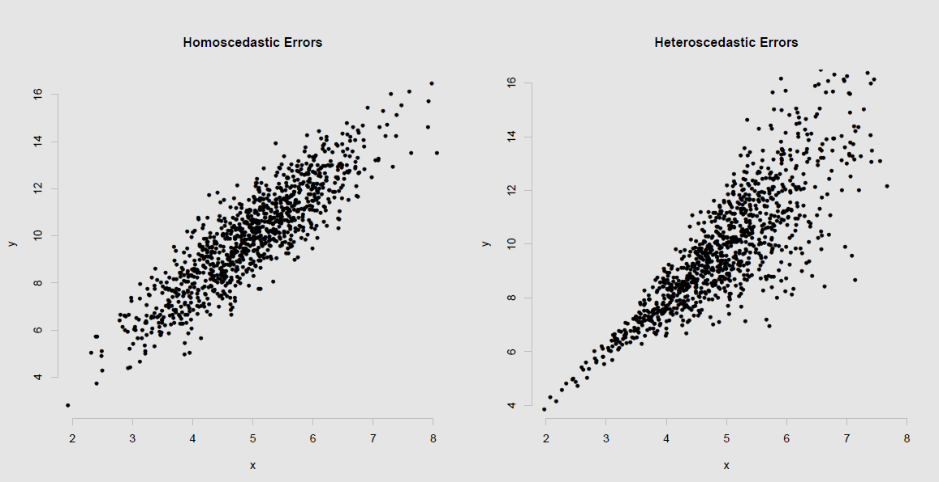
Graphically: Heteroscedasticity (Again from scatter plot)

